Slide 1
CS 316: Introduction to Deep Learning
Forward Propagation, Backward Propagation, and Computational Graphs
Week 7
Dr Abdul Samad

Slide 2
Lecture Outline
Forward Propagation
Computational Graphs
Backward Propagation

Slide 3
Forward Propagation
Refers to the calculation and storage of intermediate variables (including outputs) for a neural network in order from the input layer to the output layer.

Slide 4
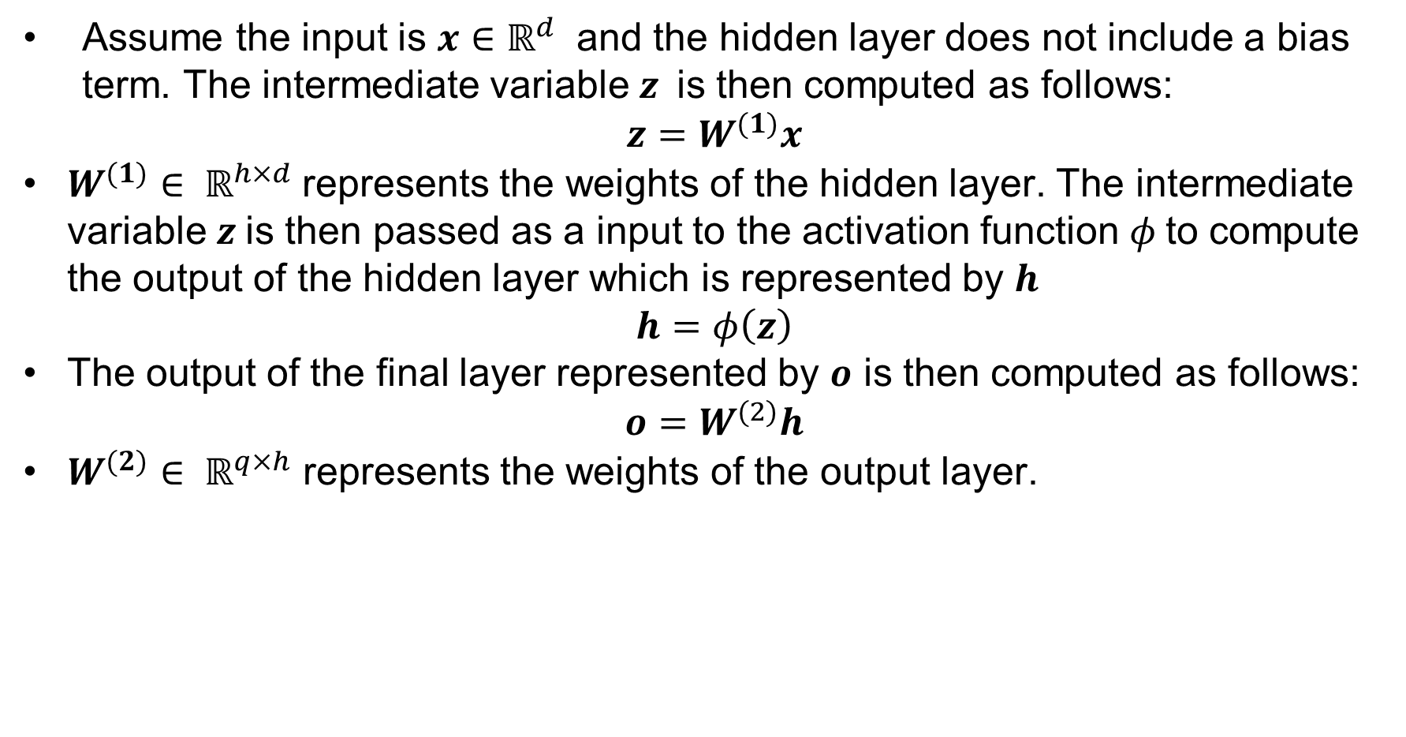
Forward Propagation in a MLP with one hidden layer
Assume the input is $x∈ℝ^{d}$ and the hidden layer does not include a bias term. The intermediate variable $z$is then computed as follows:
$$z=W^{(1)}x$$
$W^{(1)}∈ ℝ^{h×d}$represents the weights of the hidden layer. The intermediate variable $z$is then passed as a input to the activation function $φ$to compute the output of the hidden layer which is represented by $h$
$$h=φ\left(z\right)$$
The output of the final layer represented by $o$ is then computed as follows:
$$o=W^{(2)}h$$
$W^{(2)}∈ ℝ^{q×h}$ represents the weights of the output layer.

Slide 5
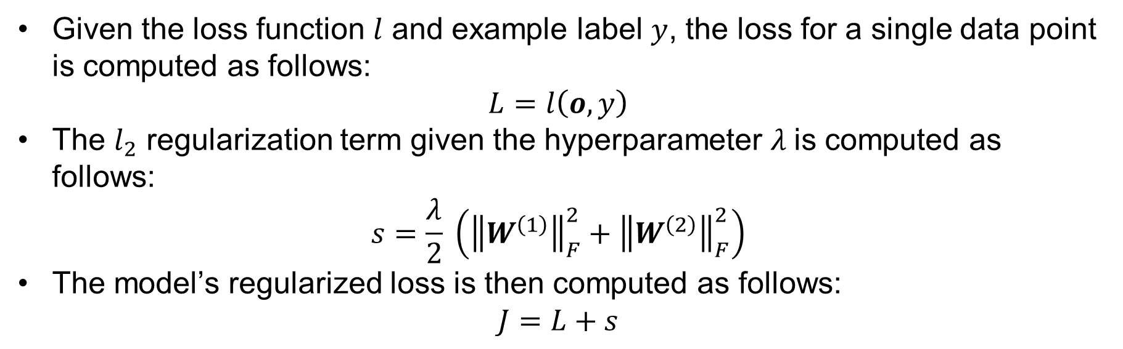
Forward Propagation in a MLP with one hidden layer
Given the loss function $l$ and example label $y$, the loss for a single data point is computed as follows:
$$L=l\left(o,y\right)$$
The $l_{2}$ regularization term given the hyperparameter $λ$is computed as follows:
$$s=\frac{λ}{2} \left({\left\|W^{\left(1\right)}\right\|}_{F}^{2}+{\left\|W^{\left(2\right)}\right\|}_{F}^{2}\right)$$
The model’s regularized loss is then computed as follows:
$$J=L+s$$

Slide 6
Computational Graphs
Computational graphs helps us visualize the dependencies of operators and variables within the calculation.
The squares denotes the variables and circles denotes the operators. The lower left corner indicates the input and upper right corner indicates the output.
The directions of the arrows (which illustrate data flow) are primarily rightward and upward.

Slide 7
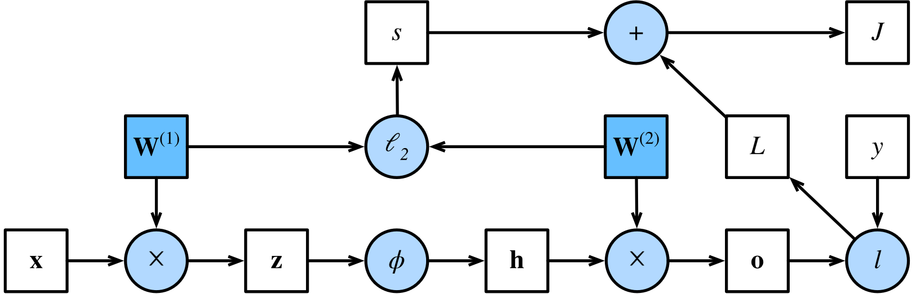
Computational Graph of MLP with one hidden layer
Figures taken from Computational Graph

Slide 8
Backward Propagation
Backpropagation refers to the method of calculating the gradient of parameters of the neural network with respect to the loss function.
The method traverses the network in reverse order, from the output of the input layer, according to the chain rule from calculus.
The algorithm stores any intermediate variables required while calculating the gradient with respect to some parameters.

Slide 9

Backward Propagation using Chain Rule
Assume that we functions $Y=f\left(X\right)$ and $Z=g\left(Y\right)$in which the input and output $X,Y,Z$are tensors of arbitrary shapes.
By using the chain rule, we can compute the derivative of $Z$with respect to $X$ as follows:
$\frac{δZ}{δX}=prod(\frac{δZ}{δY}$, $\frac{δY}{δX})$

Slide 10
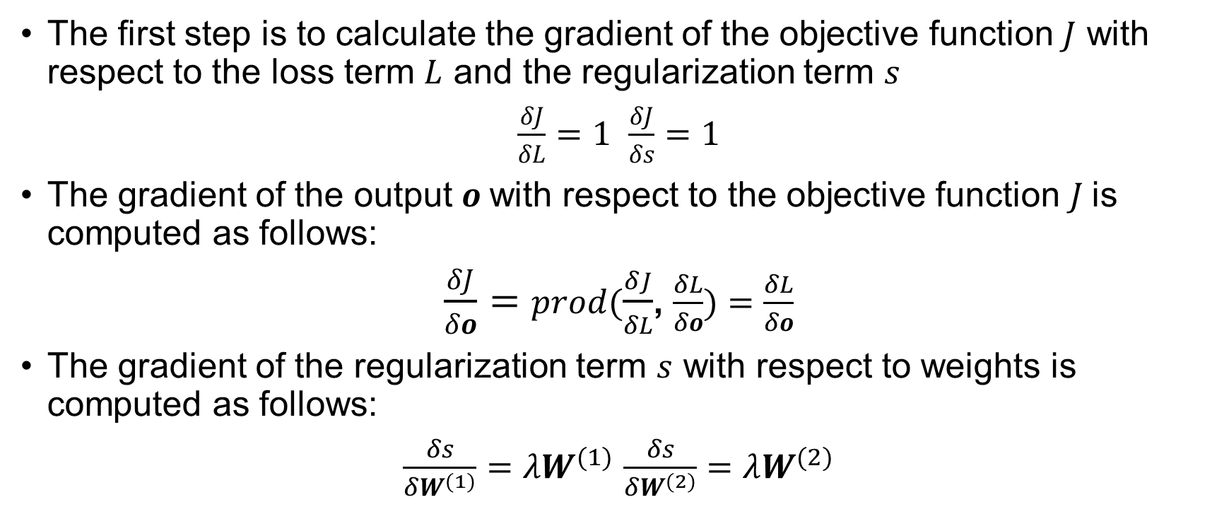
Backward Propagation in a MLP with one hidden layer
The first step is to calculate the gradient of the objective function $J$ with respect to the loss term $L$ and the regularization term $s$
$\frac{δJ}{δL}=1$ $\frac{δJ}{δs}=1$
The gradient of the output $o$with respect to the objective function $J$is computed as follows:
$\frac{δJ}{δo}=prod(\frac{δJ}{δL}$, $\frac{δL}{δo})=$ $\frac{δL}{δo}$
The gradient of the regularization term $s$ with respect to weights is computed as follows:
$\frac{δs}{δW^{(1)}}=λW^{(1)}$ $\frac{δs}{δW^{(2)}}=λW^{(2)}$

Slide 11
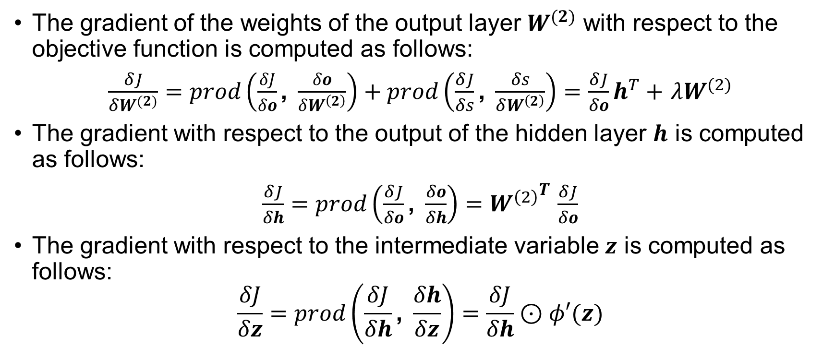
Backward Propagation in a MLP with one hidden layer
The gradient of the weights of the output layer $W^{(2)}$ with respect to the objective function is computed as follows:
$\frac{δJ}{δW^{(2)}}=prod\left(\frac{δJ}{δo}\text{, }\frac{δo}{δW^{\left(2\right)}}\right)+prod\left(\frac{δJ}{δs}\text{, }\frac{δs}{δW^{\left(2\right)}}\right)=$ $\frac{δJ}{δo}h^{T}+$ $λW^{(2)}$
The gradient with respect to the output of the hidden layer $h$ is computed as follows:
$\frac{δJ}{δh}=prod\left(\frac{δJ}{δo}\text{, }\frac{δo}{δh}\right)={W^{\left(2\right)}}^{T}$ $\frac{δJ}{δo}$
The gradient with respect to the intermediate variable $z$ is computed as follows:
$$\frac{δJ}{δz}=prod\left(\frac{δJ}{δh}\text{, }\frac{δh}{δz}\right)=\frac{δJ}{δh}⊙φ′(z)$$

Slide 12

Backward Propagation in a MLP with one hidden layer
Finally, the gradient of the weights of the hidden layer $W^{(1)}$ with respect to the objective function is computed as follows:
$\frac{δJ}{δW^{(1)}}=prod\left(\frac{δJ}{δz}\text{, }\frac{δz}{δW^{\left(1\right)}}\right)+prod\left(\frac{δJ}{δs}\text{, }\frac{δs}{δW^{\left(1\right)}}\right)=$ $\frac{δJ}{δz}x^{T}+$ $λW^{(1)}$

Slide 13


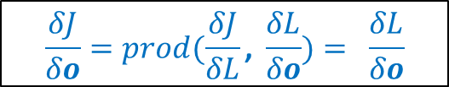
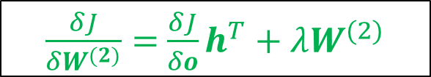


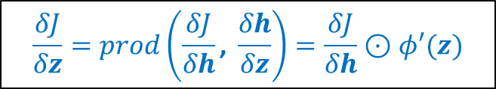






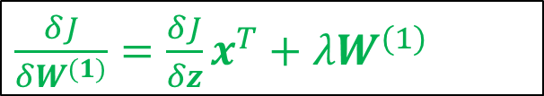
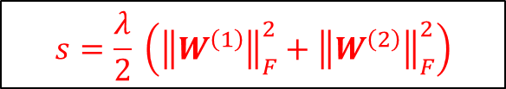
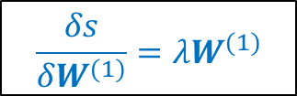
Forward and Backward Propagation in a Computational Graph
$$J=L+s$$
$$\frac{δJ}{δs}=1$$
$$\frac{δJ}{δL}=1$$
$$s=\frac{λ}{2} \left({\left\|W^{\left(1\right)}\right\|}_{F}^{2}+{\left\|W^{\left(2\right)}\right\|}_{F}^{2}\right)$$
$$L=l\left(o,y\right)$$
$$\frac{δs}{δW^{(1)}}=λW^{(1)}$$
$$\frac{δs}{δW^{(2)}}=λW^{(2)}$$
$$z=W^{(1)}x$$
$$h=φ\left(z\right)$$
$$o=W^{(2)}h$$
$$\frac{δJ}{δz}=prod\left(\frac{δJ}{δh}\text{, }\frac{δh}{δz}\right)=\frac{δJ}{δh}⊙φ′(z)$$
$\frac{δJ}{δh}=prod\left(\frac{δJ}{δo}\text{, }\frac{δo}{δh}\right)={W^{\left(2\right)}}^{T}$ $\frac{δJ}{δo}$
$$\frac{δJ}{δo}=prod(\frac{δJ}{δL}\text{, }\frac{δL}{δo})= \frac{δL}{δo}$$
$\frac{δJ}{δW^{(1)}}=\frac{δJ}{δz}x^{T}+$ $λW^{(1)}$
$\frac{δJ}{δW^{(2)}}=$ $\frac{δJ}{δo}h^{T}+$ $λW^{(2)}$

Slide 14
References
https://d2l.ai/chapter_multilayer-perceptrons/backprop.html#

